Slide 1
Shakespeare’s Musicality
Profesor: Stupu Mariana-Luminiţa
Colegiul Tehnic “Gheorghe Asachi“-Oneşti

Slide 2
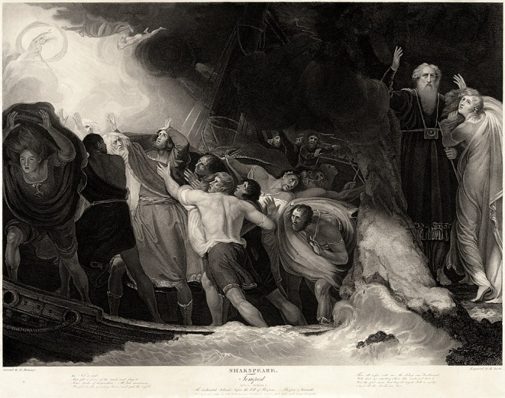
“The Tempest“ is William Shakespeare’s
most mature and admired play.
It is among his finest plays in terms
of its musicality.

Slide 3
G. B. Harrison has written the following appraisal of the language of the play:
«Shakespeare, like all Elizabethan dramatists, used four kinds of speech in his plays: blank verse, rhymed verse, prose and song.
Each kind has its uses, and the whole play, especially in his maturity is conceived as a kind of verbal symphony, each scene oe episode being composed as part of a complete harmony.
“The Tempest “ in its poetical scenes is the finest example of the musical use of words in all Shakespeare’ s plays.»
(Mayor British Writers. New York. Harcourt, 1959)

Slide 4
Sprite‘s song best exhibits musicality and has an incantatory quality to describe an event as horrifying as the drowning of Fernando’s father:
«Full fathom five thy father lies,
Of his bones are coral made:
Those are pearls that were his eyes,
Nothing of him that doth fade,
But doth suffer a sea-change
Into something rich and strange
Sea-nymphs hourly ring his knell:
Hark! now I hear them-ding-dong, bell. »
(1.2.456)

Slide 5
An invisible Ariel uses beautiful music to coax a shipwrecked, disillusioned Ferdinand from the shore to Miranda:
«Come unto these yellow sands,
  And then take hands:
  Curtsied when you have, and kiss’d
  The wild waves whist,
  Foot it featly here and there;
  And, sweet sprites, the burthen bear.
  Hark, hark! »
  (I.ii.380-387)

Slide 6
“The Tempest“ is a play of unique magical creatures of the earth, and the air, of harmonious song and discordant sounds, of life, death and the hope of regeneration.
It is a symphony of poetry and music and it appeals consciously to the audience to partake in its artifice and art.

Slide 7
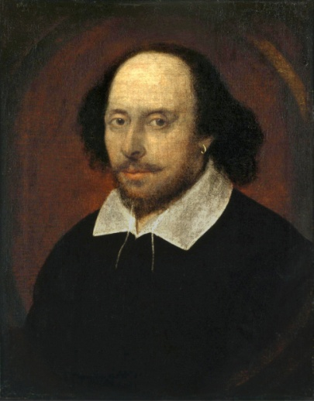
Bibliography:
Boughton, Rutland. “Shakespeare's Ariel: A study of Musical Character.“ The Musical Quarterly, vol 2, No 4
Orgel, Stephen. “Introduction“ , The Tempest, Oxford Shakespeare, Oxford U.P., 2008

