Slide 1
THE INTERNATIONAL CONFERENCE
The Voice of Education on European Level
CIOCLU ANINA-RAMONA
Prof. Limba engleză
Colegiul Tehnic “Gheorghe Asachi” Onești, Bacău
Bulevardul Republicii, Nr 45, Cod 601137

Slide 2
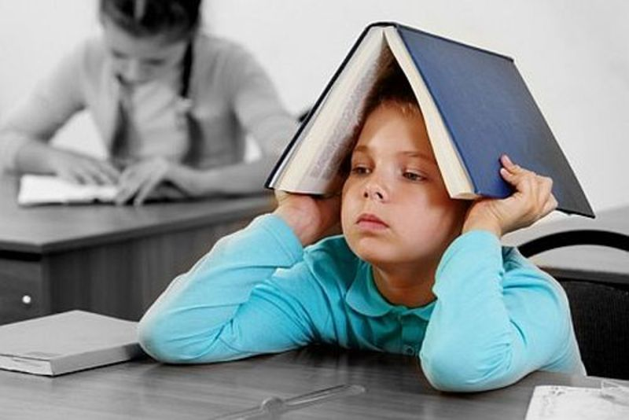
THE INTERNATIONAL CONFERENCE
The Voice of Education on European Level
EDUCATION- THE ULTIMATE REMEDY FOR THIS GENERATION

Slide 3
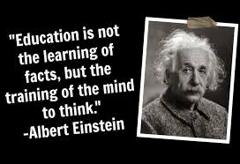
When we think of education a lot of issues come into our minds: our own experiences in school, the problems in Romanian schools, the laws given by The Ministry of Education (which change frequently) and the confusion sensed by the students who strive to become SOMEBODY in life.
Could there be a model of education which might give us hope that the results seen in our students will correspond to the investments the teachers and parents make?

Slide 4
‘The Romanian education grows individuality, selfishness. Romania is full of contests. We are fed up with medalists. It is imperious that the students should be ranked’
        (Dan Pracsiu, trainer of The National Computer Science group who has accompanied the group of students to International competitions ever since 2012, in the newspaper ‘The Truth’)
‘School in Romania is horrible…It is a school where everybody is afraid of everybody: the students are afraid of their educators, teachers are afraid of the school head masters, head masters are afraid of inspectors and fear annihilates any trace of enthusiasm of discovering, of learning!’
(Florin Colceag, member of the Commission of specialists who work in sketching reforms
in primary education. He trained over 300 champions and over endowed students.)

Slide 5
‘School offers preparation for exams, but not for life. It transmits competences and abilities for labour market, but not abilities for life’.
(Philip Graham, The End of Adolescence, Oxford University, 2004)

Slide 6
It is now a generation of the Internet (digital minds), who has another attitude towards information and towards teaching. But the teachers take as examples of what teaching means the teachers they themselves had when they were students and they think that being a good teacher often means to be as their teachers used to be.
Mircea Miclea, 2015

Slide 7
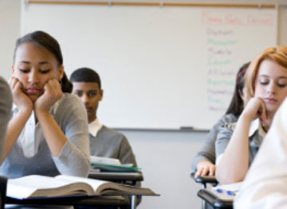

The holistic development of the teenager
Imagine a child or a teenager who goes to school in the morning, sits down for 6 hours, his back bent, his lungs pressed, without being able to breathe correctly, then he comes back home, eats and starts again studying, his/her head bent over the books, and after that he/she goes to sleep. At the first sight he/she seems a laborious student. He/she will become SOMEBODY in life.
Why, then, they look so exhausted, powerless, and, even if they know a lot, they relate so hard with the others and they behave as if they were incompetent?
This is just because teenagers need a holistic development, not just an intellectual one.
Holistic – a concept which takes into consideration all the factors that affect the state of well being; an overall picture over all the beneficial factors of a person.

Slide 8
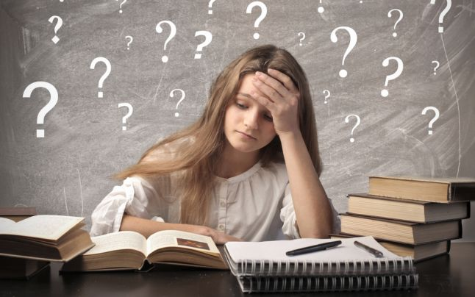
Searching the light!
A type of copy – paste education is not only an inefficient one, but also a misleading one; it creates only a vague impression of something efficient.
Modern education is more preoccupied with forming technical competent people, with people who are less interested in answering to ‘why’ and ‘for what’.
Someone may be very well prepared theoretically, and still, he/she may fail when it is about the life exam.

Slide 9


“The only purpose of education is the one of transforming the mirrors into windows”
SydneyHarris

Slide 10
THE REAL EDUCATION DEVELOPS HOLISTICALLY
1. Physically
2. Socially
3. Emotionally
4. Morally/spiritually
5. Intellectually

Slide 11

1. Physical education
‘Because the mind and the soul express themselves through the body, the vigor of mind and the spiritual side depend on the physical activity. Anything that brings physical health, brings also a development of a witty mind, of a well balanced character. Health should be taken care of as of our character’.
E.G. White, Education, p. 187.
After some hours of sitting down, the lungs pressed, with non-oxygenated brains, the physical activity will become a real pleasure, if it is done consciously and the student will notice an improvement, he/she will be more efficient.
So, this part of education shouldn’t be neglected.

Slide 12
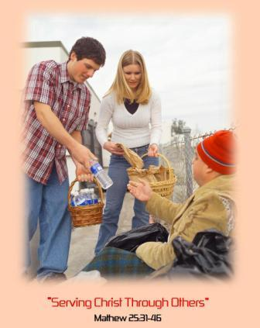

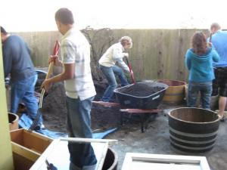
2. Social education
Teenagers feel the need of socialising, of talking to each other. Famous universities from USA, France, Great Britain noticed that the teenagers who graduate university or post university studies are selfish and they don’t do almost anything for the others, but they are interested mostly in their own person.
Teenagers should be encouraged to spend time with orphans, old people, people with disabilities. Thus, they will built altruism, share love and help, communication, socialisation; they will learn what care, charity, simplicity, kindness mean. They will learn how to cherish life and appreciate it. They will learn respect for themselves, for others, for life.

Slide 13
3. Emotional education
Warm relationships with the relatives, taking time to have real talk with them, not only to give information, but to share feelings, emotions, these are essential for a healthy character.
Teachers have a huge responsibility regarding the emotional side of the students as they can be real counsellors, mentors, advisors, thus showing to them that they are interested in their development as human beings, not only in transmitting information.

Slide 14

4. Moral/spiritual education
Altruism
Honesty
Kindness
Integrity
Correctitude
Values and non- values
Each of us has a perspective over life (some people think that there is no chance in life if you work honestly, others think that nobody helps you when you are in need, some believe in fate and luck, some others that it’s no use being moral, some that it’s not worth investing time in studying, etc).
Do we invest in nowadays education, in forming true values of a healthy life vision? Do the parents promote a healthy environment for the world we live in? Are values as kindness, correctitude, integrity, honesty, altruism promoted any more? Or we care only of performances, being on top and we forget about respect, kindness, common sense. It seems that nowadays what matters most is competition, being better than the others, more performing, more successful, and we forget about collaboration.
Ellen White states: ‘ The true education doesn’t ignore the value of scientific knowledge or of the literary values; it emphasises power over information; over power kindness; over intellectual culture character. The world doesn’t needs so much strong intellectual people as it needs people with noble character.’ (Education, p. 225).
The Germans were the first in promoting the idea of Weltanschaung = vision about life. That is why the foreign people work better in teams than the Romanians; when you fill in a CV it is very important to be a good team worker.

Slide 15
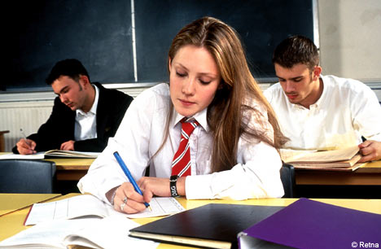

5.Intellectual education
In such an educational system, as we have nowadays, it seems that we don’t have time for anything else but for the intellect. The general tendency is that the teenager has only to study hard, that there is no time for anything else. But the reality is that the one that studies only for the intellect will get exhausted intellectually soon and he/she will nor have efficiency anymore. Scientific studies show that the one who takes time also for the other fields of development will have a better efficiency.

Slide 16
BIBLE ON THE FIRST PLACE
We feel so full of ourselves nowadays, so intellectual , but we forget about the holistic education, education which is given by the Bible. It is not hard to find it, but we think less of it, we think it is obsolete and, in the same time, we complain that we don’t empathise anymore, that we don’t communicate, that we feel lonely, that there is no consideration for the others. We should reconsider it!
I think we should be more careful in investing in character, in building healthy human beings and not robots ready to transmit information, but who forget to communicate and care.
I think this is the way education should go, but, in the same time, not to forget about knowledge.
School shouldn’t be just a storage of information but an oasis of kindness, equilibrium, open heartedness, collaboration and efficacy.

Slide 17
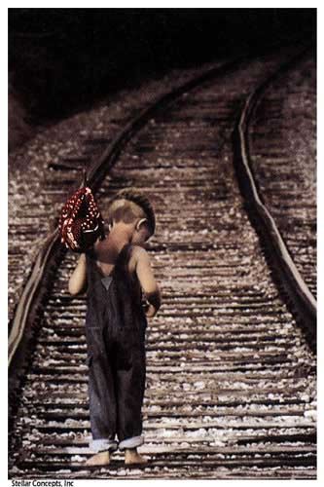
Don’t forget! You were a child too!

